Slide 1
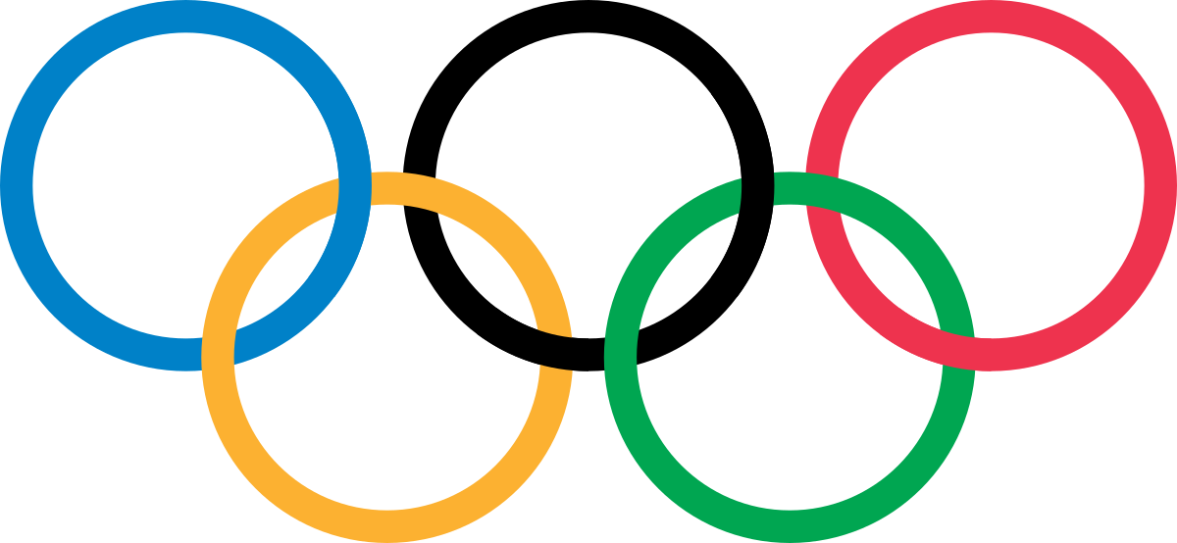
Research Presentation
PREDICTING ATHLETE SPONSORSHIPS WITH THE 2016 RIO OLYMPIC GAMES
Team: Deanna Zarrillo, Jeff Thomson, Sathish Kumar Rajendiran

Slide 2
OVERVIEW
OBJECTIVES & DATA QUESTIONS
2.
DESCRIPTIVE & EXPLORATORY ANALYSIS
3.
PREDICTIVE & STATISTICAL ANALYSIS

Slide 3
OBJECTIVES
To clean up the data sets, understand the data’s strengths and weaknesses, enhance areas with meaningful data and validate for data consistency
To take meaningful data and create intuitive visualizations to be used for further analysis and pattern spotting
To use the identified patterns to build models which may be able to predict the attributes that positively correlate with medals earned

Slide 4
DATA QUESTIONS
Does an athlete’s estimated BMI affect their chances of winning a medal?
Is there a relationship between country and number of medals won?
Which athletes are most likely to be sponsored?

Slide 5

TARGET AUDIENCE
Corporate sponsors:
Procter & Gamble
Airbnb
Alibaba Group
Atos
Bridgestone
The Coca-Cola Company
Dow Inc
General Electric
Intel

Slide 6

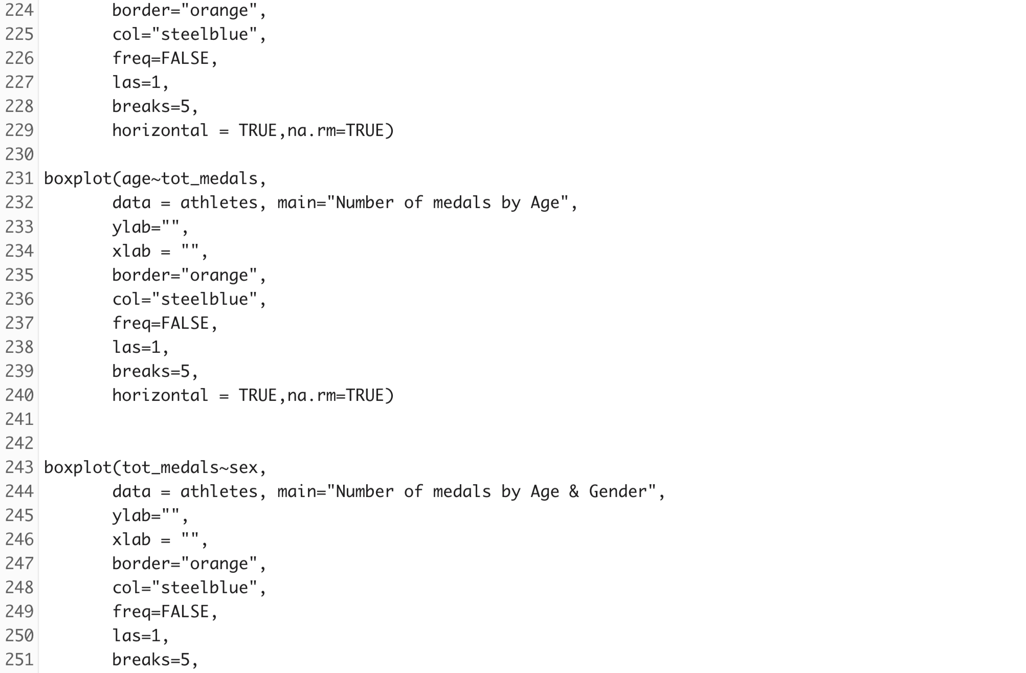
EXPLORATORY ANALYSIS
Data Clean-Up
Removing/update NA’s, changing data types, choosing meaningful columns to keep and/or rename/re-arrange
Dealing with age, weight, height, and calculating BMI
Joining additional data sets
Country data including GDP and population
Events data including venue and event name
Beginning with Histograms & Box Plots
Analyzing spread of medals by age and gender
Exploring Spread with Heat Maps
Identifying clusters where gender or a range of age or BMI show an impact on the number of medals individual athletes win
F

Slide 7
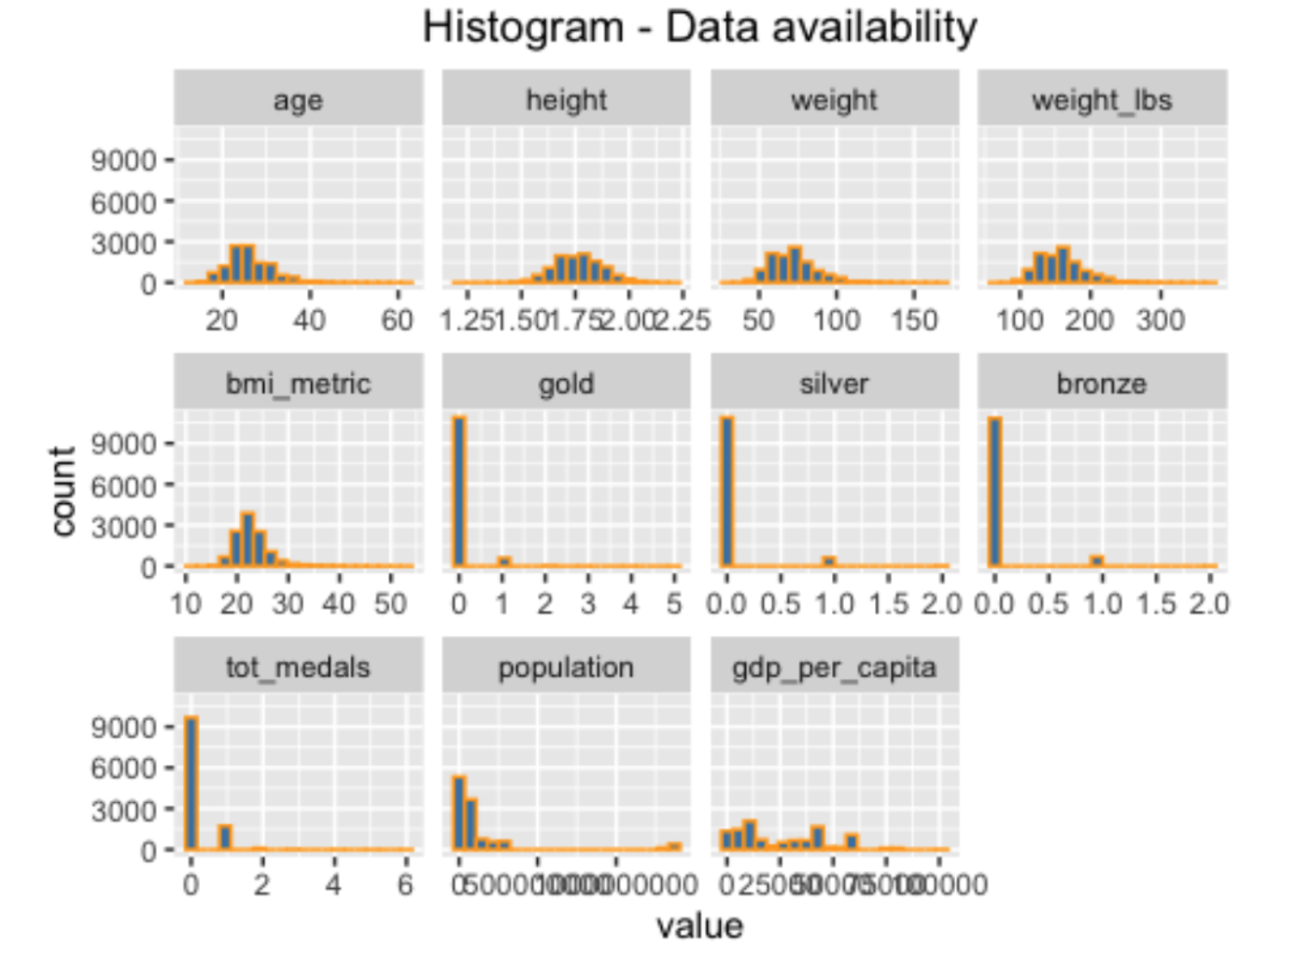
DESCRIPTIVE STATS ANALYSIS
Histograms:
These histograms show the general dispersion of each relevant entity in our dataset

Slide 8
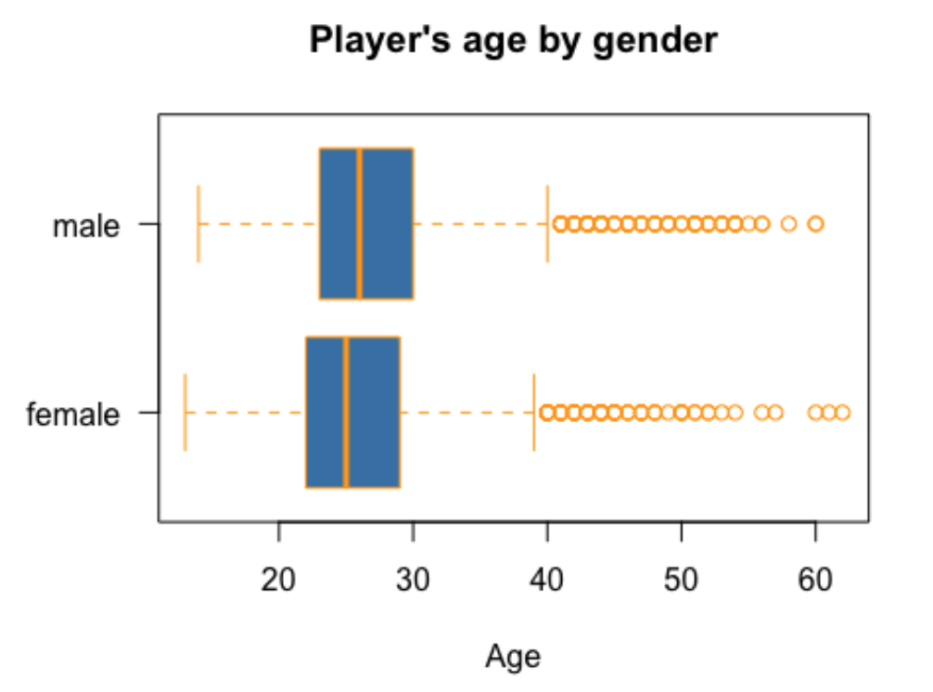
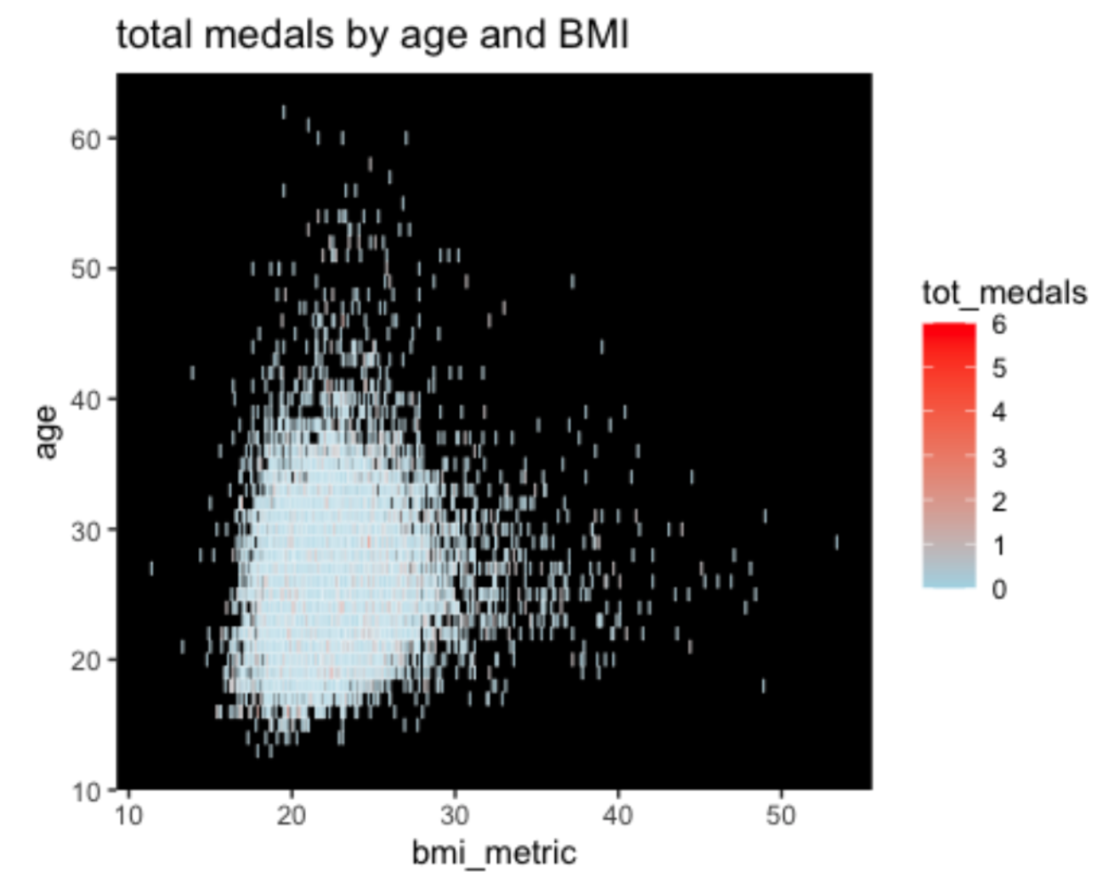
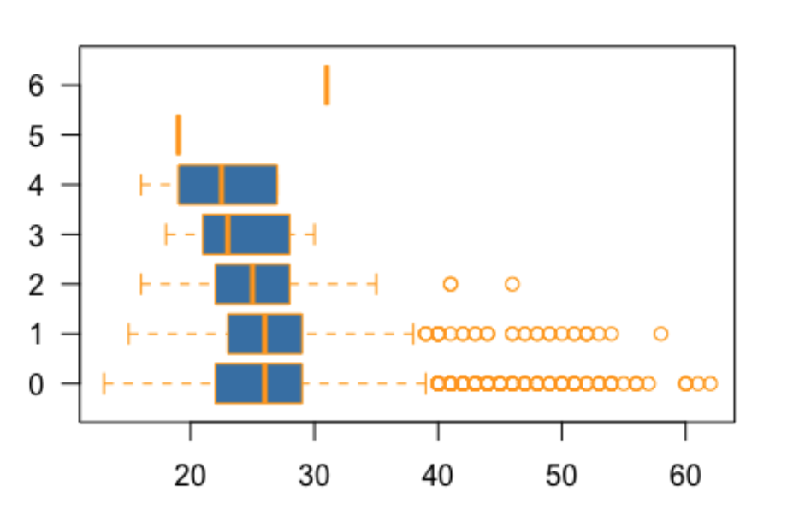
DESCRIPTIVE STATS ANALYSIS
This boxplot illustrates the average age by gender of the players. In general, there isn’t much of a difference. The average age of female players is slightly less than males.
Number of Medals by Age
This plot shows the central tendency of ages by number of medals won. In general, it seems that as more medals are won, the average age is decreasing - with the exception of one 6 medal winner in their early 30’s
This heat map shows the range of players and medals won across age and calculated BMI. The overall cluster gives an indication of the age and BMI ranges for successful athletes

Slide 9
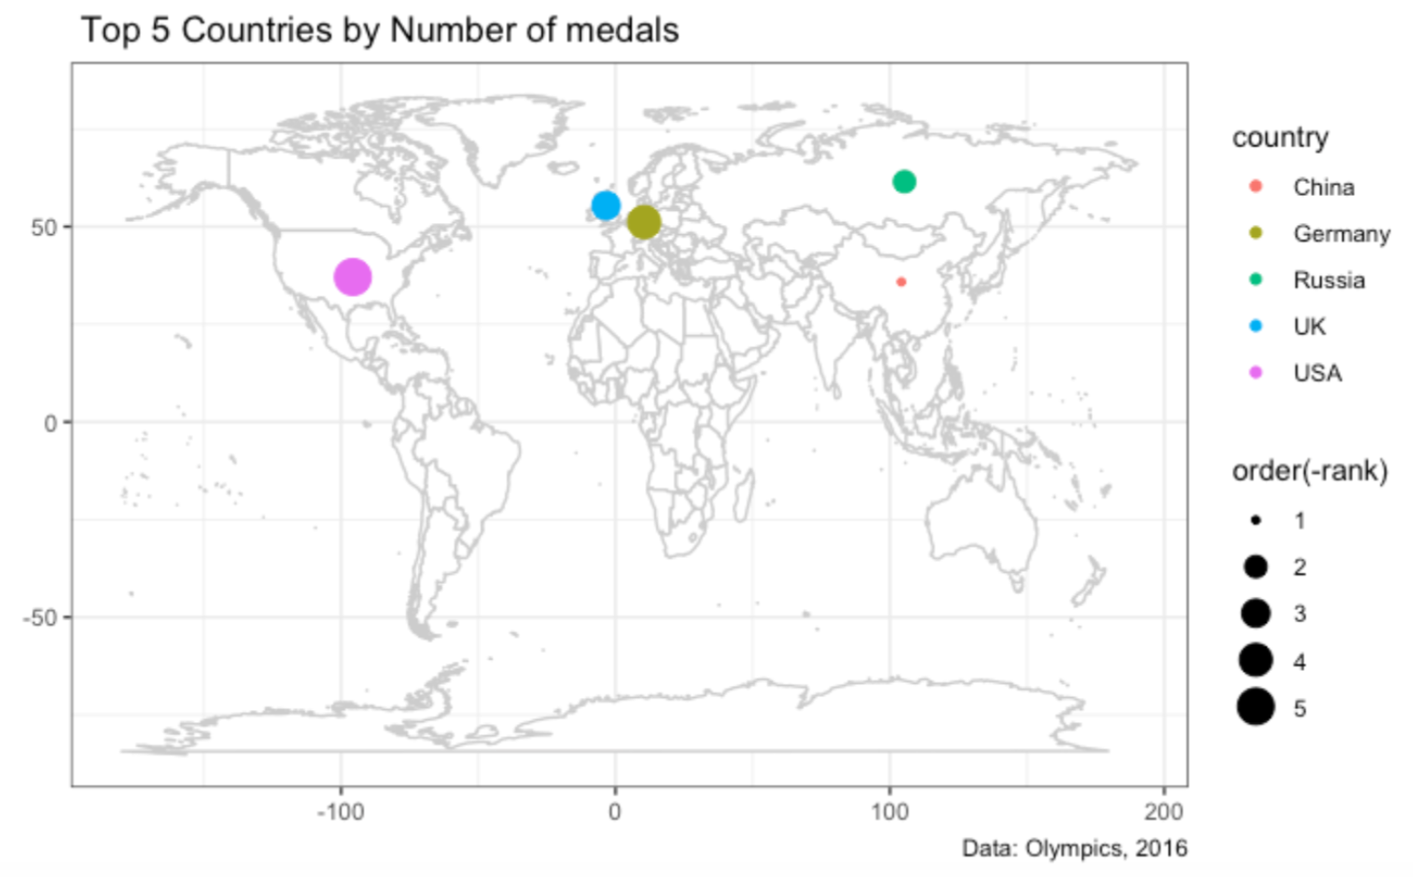
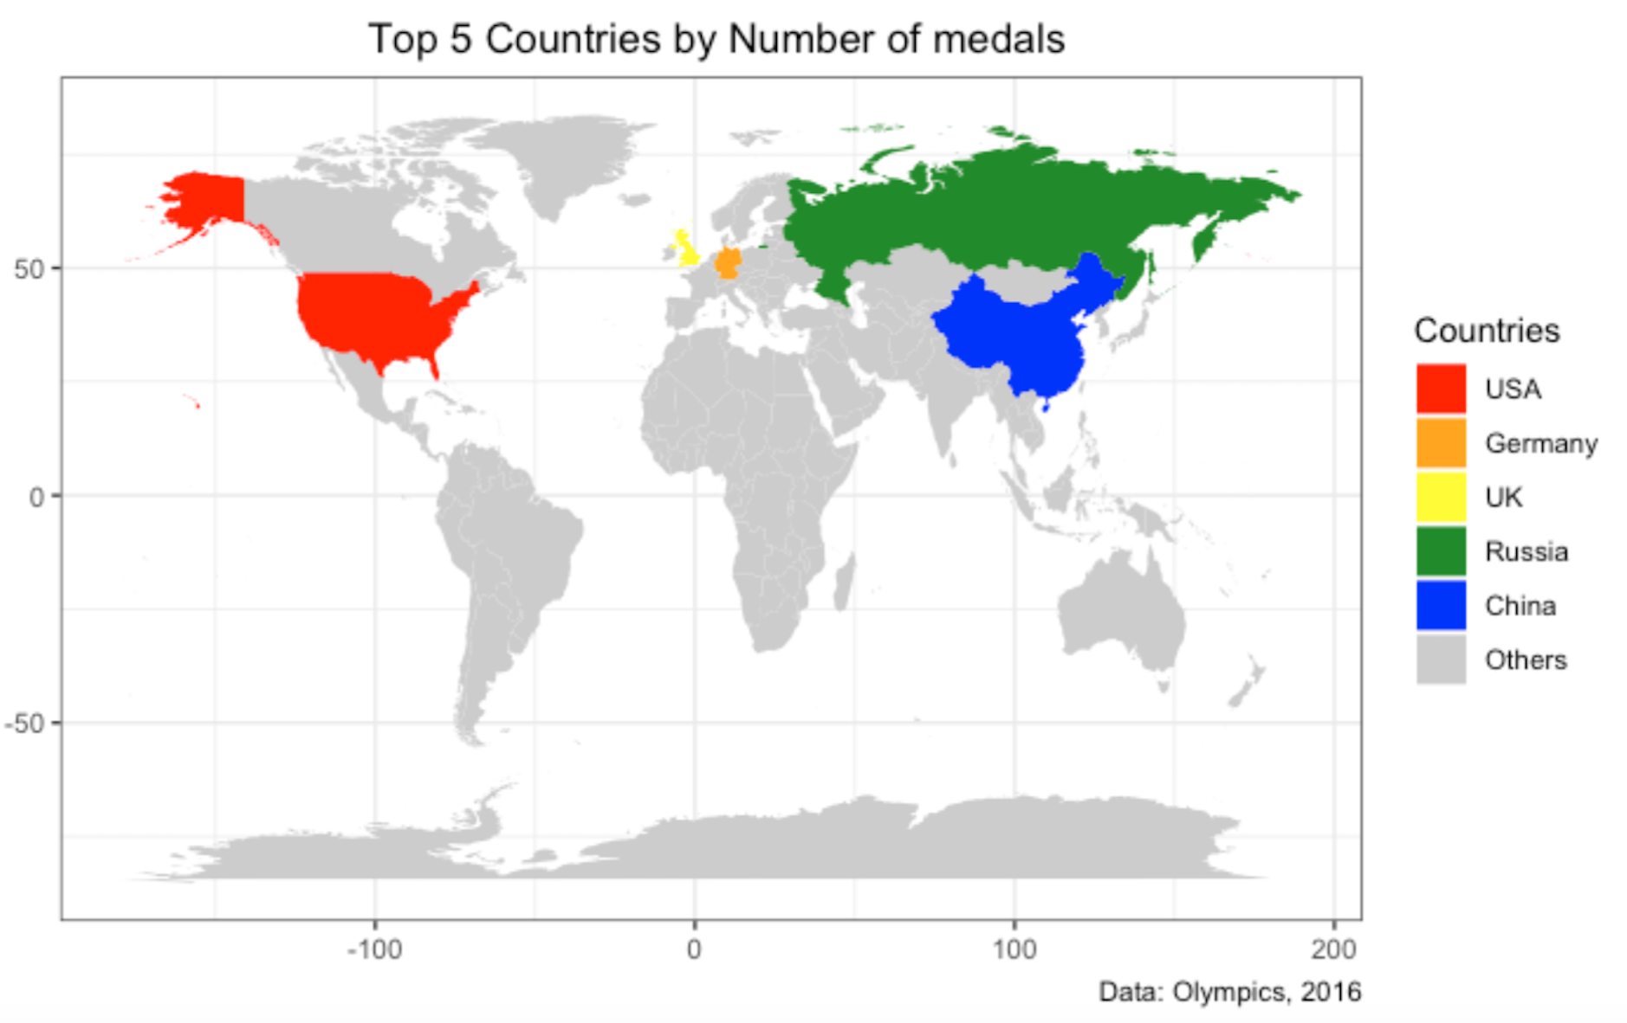
WORLD MAP: MEDALS BY TOP COUNTRIES
These maps shows the top countries by number of medals won with the USA having the most

Slide 10
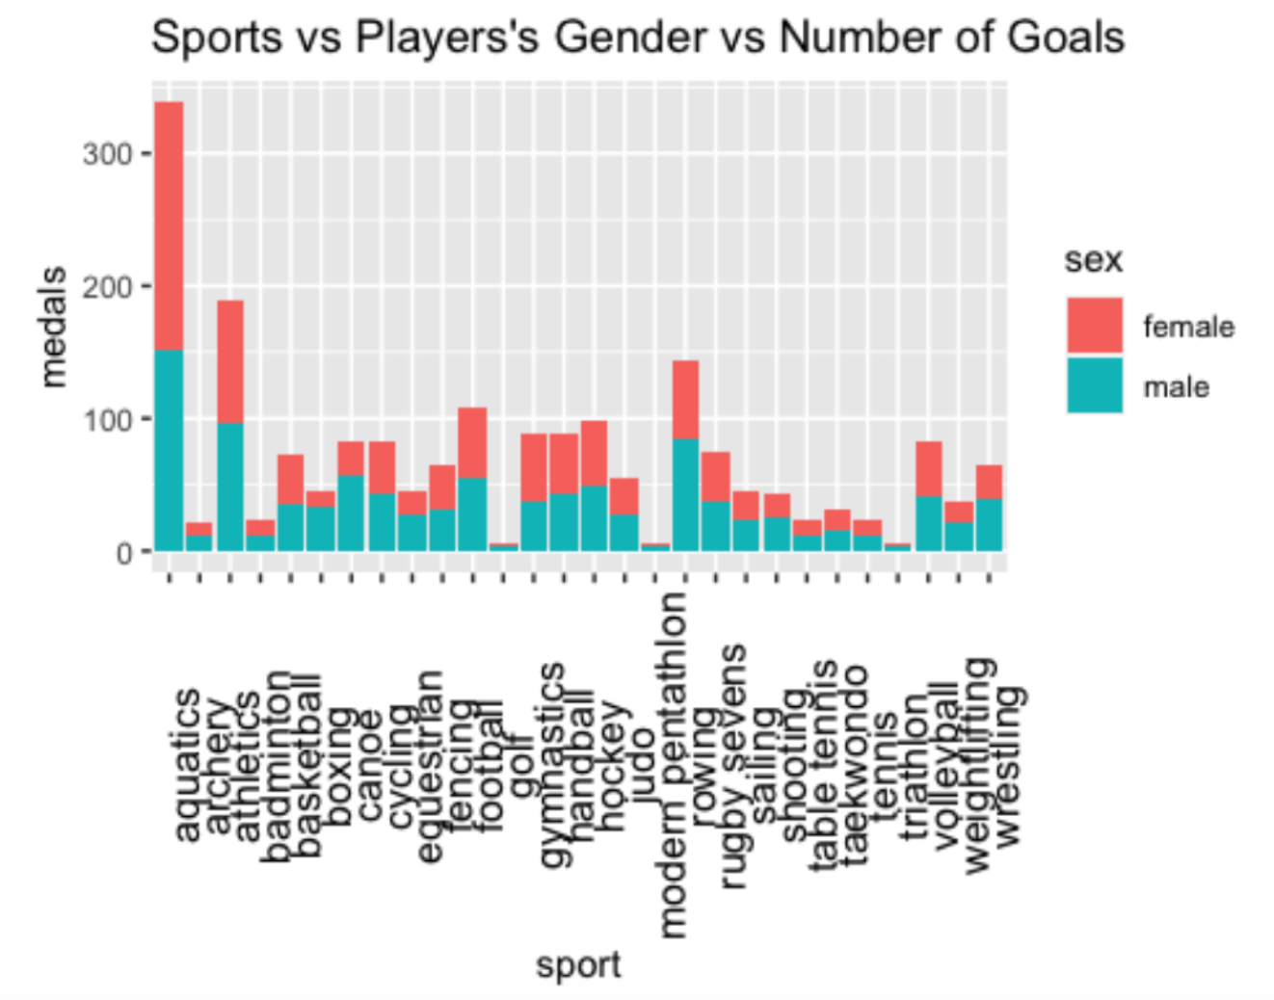
BAR CHART: MEDALS BY SPORT
The bar chart to the right shows the breakdown of medals by sport, and is further broken down into gender. Aquatics won the most medals, and more females won medals than males.

Slide 11
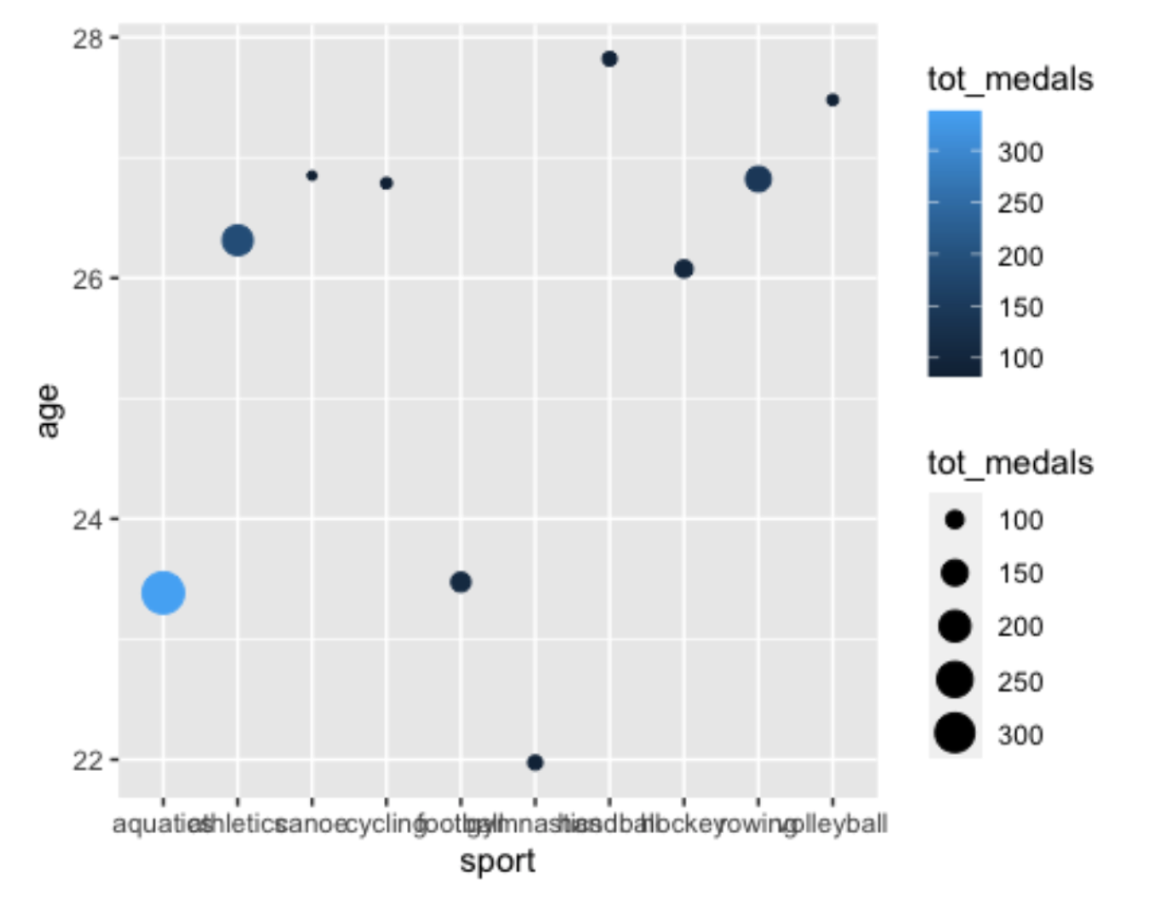
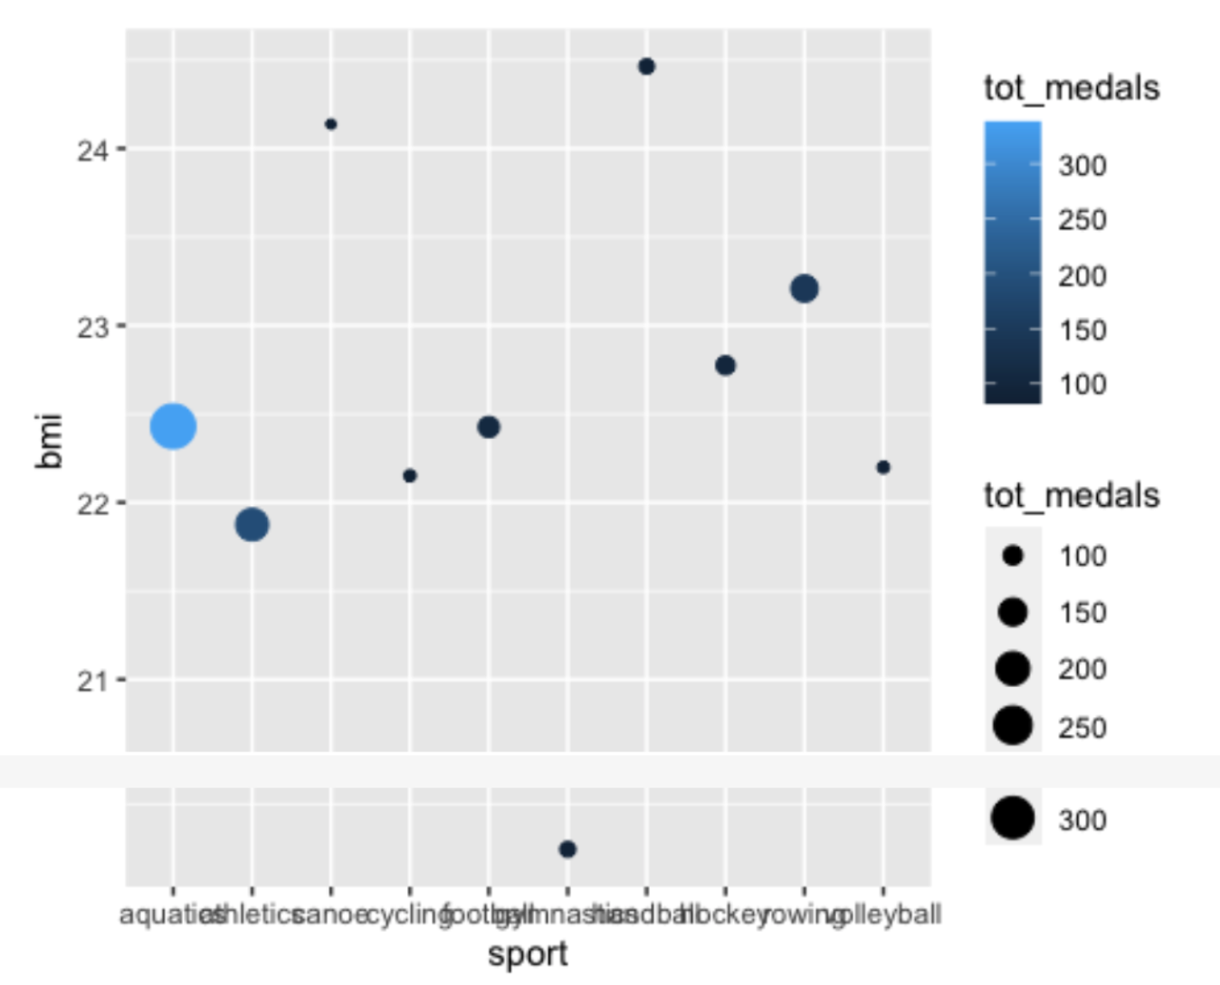
Scatter Plots: Total Medals by Sport and Age vs. by Sport and BMI
These two scatter plots dive further into the total medals awarded in a sport.

Slide 12
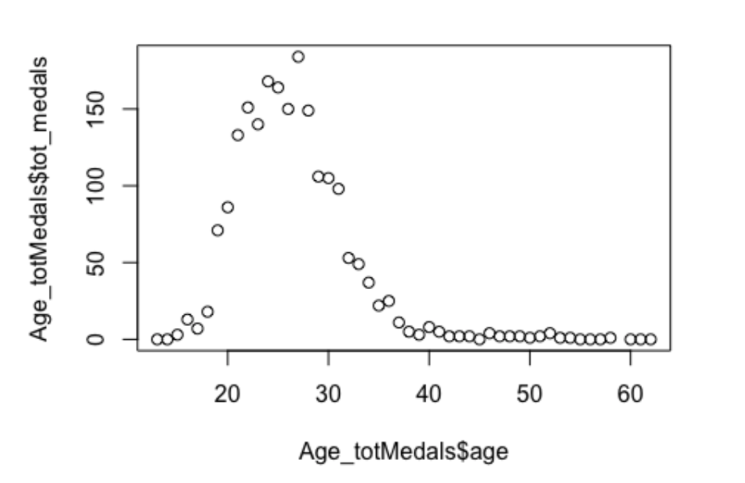
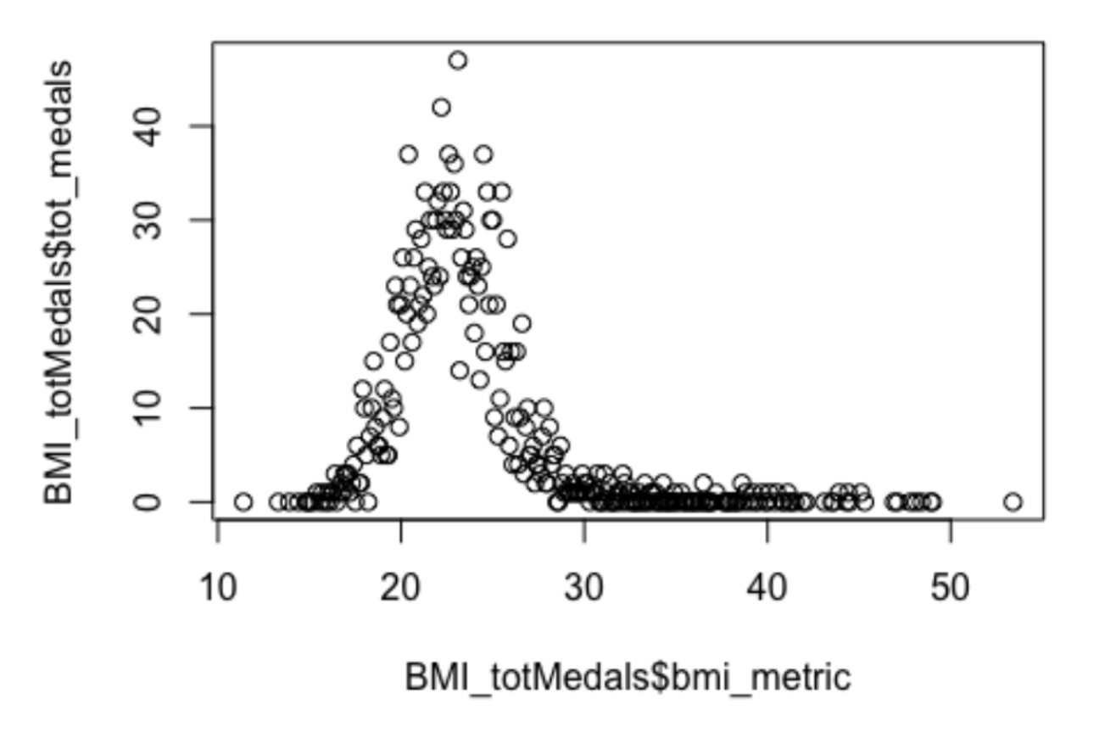
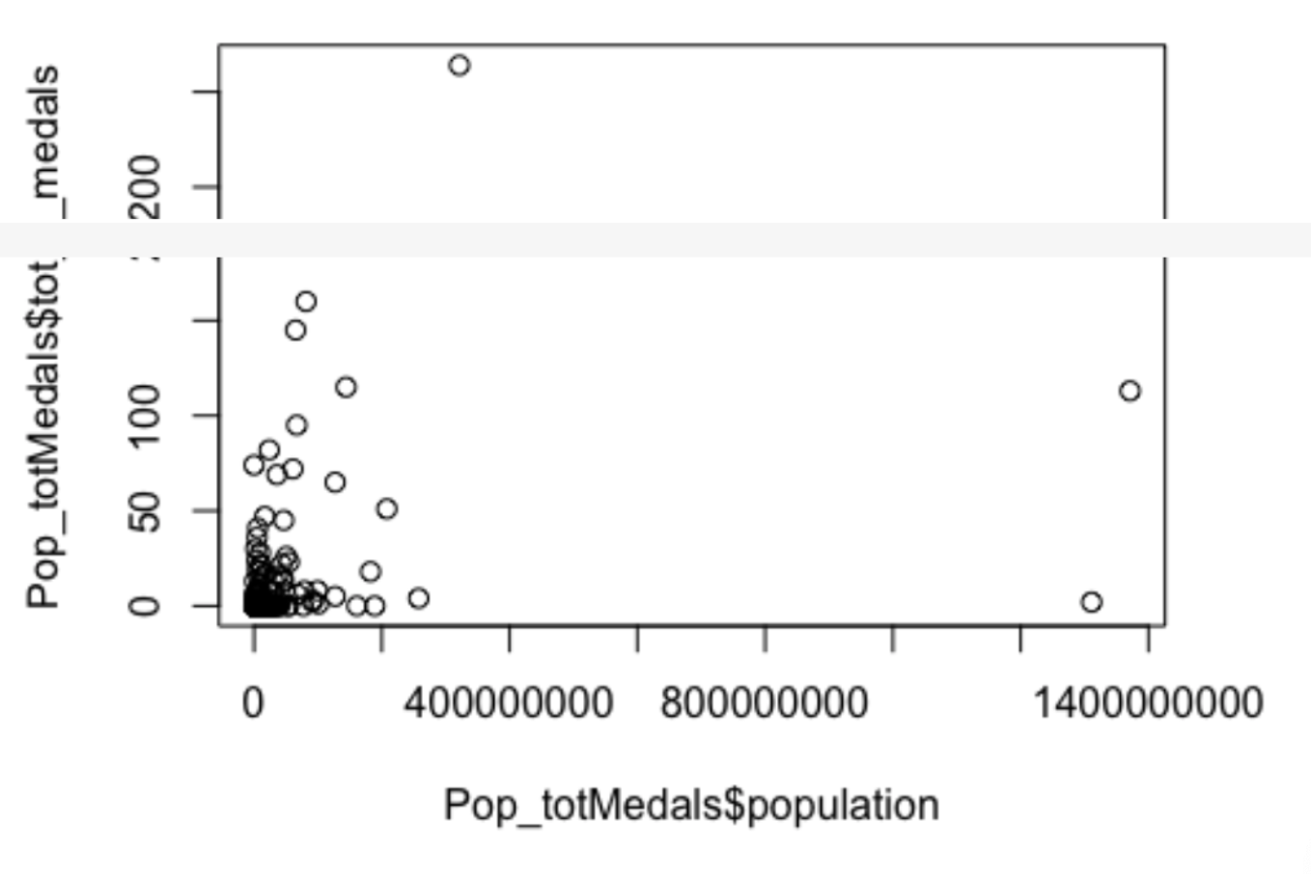
LINEAR REGRESSION*
* Likely better fit with some other regression model, however due to the scope of the project we looked instead at where we could see significant correlation to total medals
R-squared: 0.2647 p-value: 0.0000926
Assuming an alpha of 0.05, the p-value of 0.0371 indicates that age does have a correlation to total medals won
R-squared: 0.1904 p-value: 0.00000000000004687
Assuming an alpha of 0.05, the p-value of 0^-14 indicates that BMI does have a correlation to total medals won
R-squared: 0.09269 p-value: 0.00002755
Assuming an alpha of 0.05, the p-value of 0^-6 indicates that population does have a correlation to total medals won. Of note is that the p-value for BMI & population is smaller than age, so we will run the regression for age, BMI & population as out independent variables and analyze the output.

Slide 13
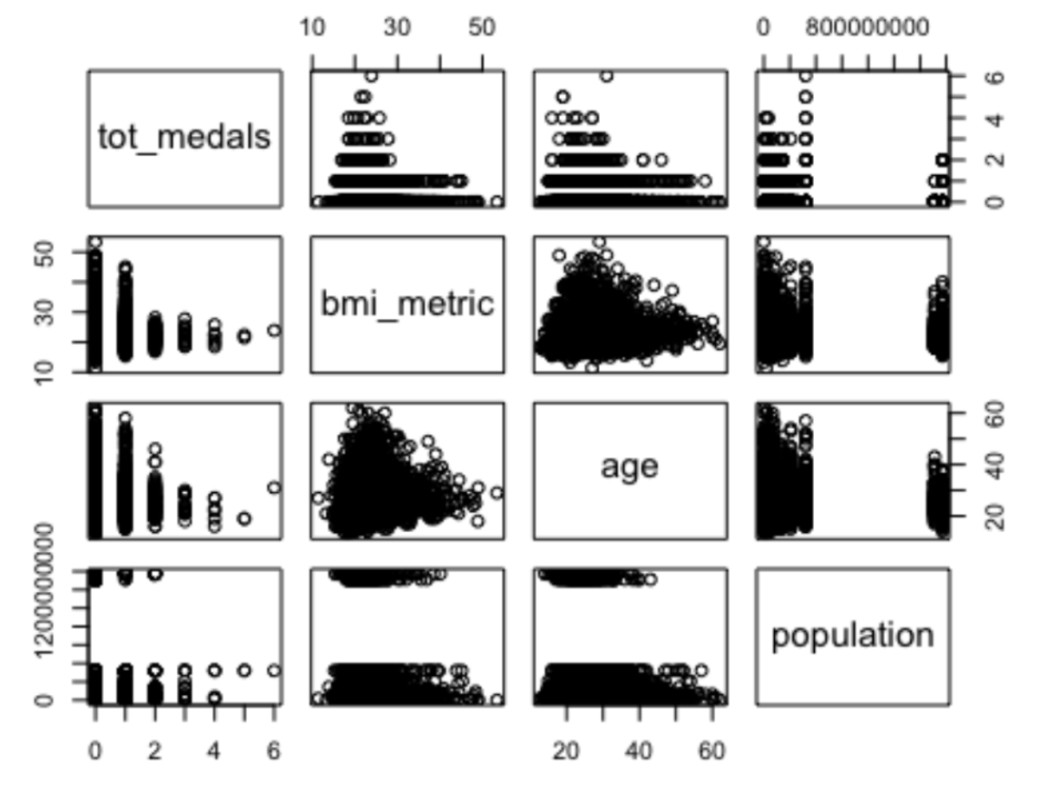
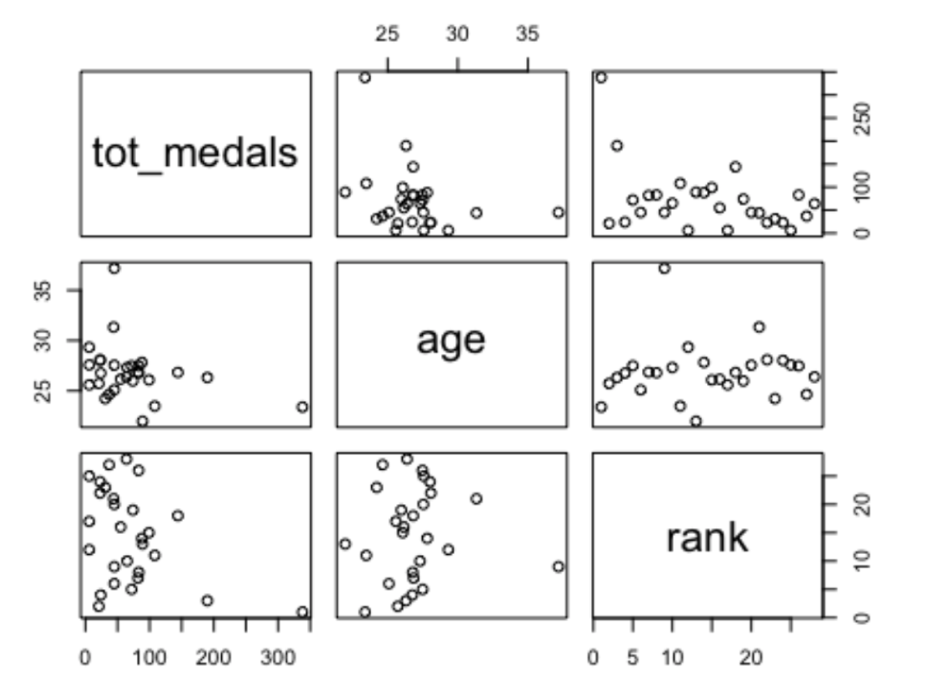
MULTILINEAR REGRESSION
From the regression output, population and BMI have a p-value below our alpha of 0.05 indicating they have a stronger correlation to total medals won than age
Predicting total medals with age and ranked sports

Slide 14
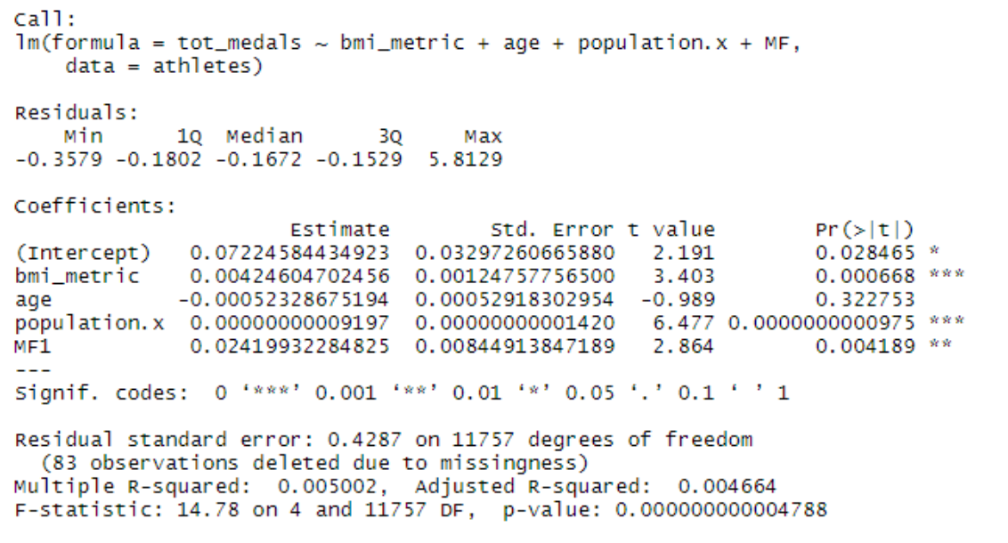
PREDICTIVE ANALYSIS
Medal prediction equation using multivariable regression model coefficients:
# Test 1
# Predict total medals for a Male with BMI = 22, is 20 years old.
# Y = 0.0722 + 0.004246x1 - 0.0005232x2 + 0.00000x3 + 0.024199x4
# Y = 0.829 so we can assume that this person will win one medals
# Test 2
# Predict total medals for a Male with BMI = 30, is 45 years old.
# Y = 0.200 medals so we can predict that this person is unlikely to win any medals

Slide 15
PRESCRIPTIVE RESULTS
Which athletes may be considered desirable for corporate sponsors?

Slide 16
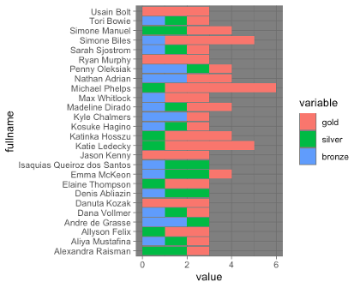
TOP ATHLETES BY BREAKDOWN OF MEDAL TYPE
The athletes above were awarded more than 2 medals in the 2016 games - a majority of these athletes are swimmers and many compete in track & field events or gymnastics.

Slide 17
THANK YOU!
Questions?

